Slide 1



Financial Analysis
View in Power BI
Last data refresh:
4/15/2024 7:26:46 AM UTC
Downloaded at:
4/15/2024 2:53:48 PM UTC

Slide 2
Introduction:
Examining the competitive landscape of India's top 500 companies is crucial for understanding the country's growth trajectory. This analysis aims to uncover key metrics influencing a company's competitiveness and identify insightful metrics derived from the provided data. Each section will delve into these aspects, providing valuable insights into the standing of Indian business titans in one of the world's largest markets.

Slide 3
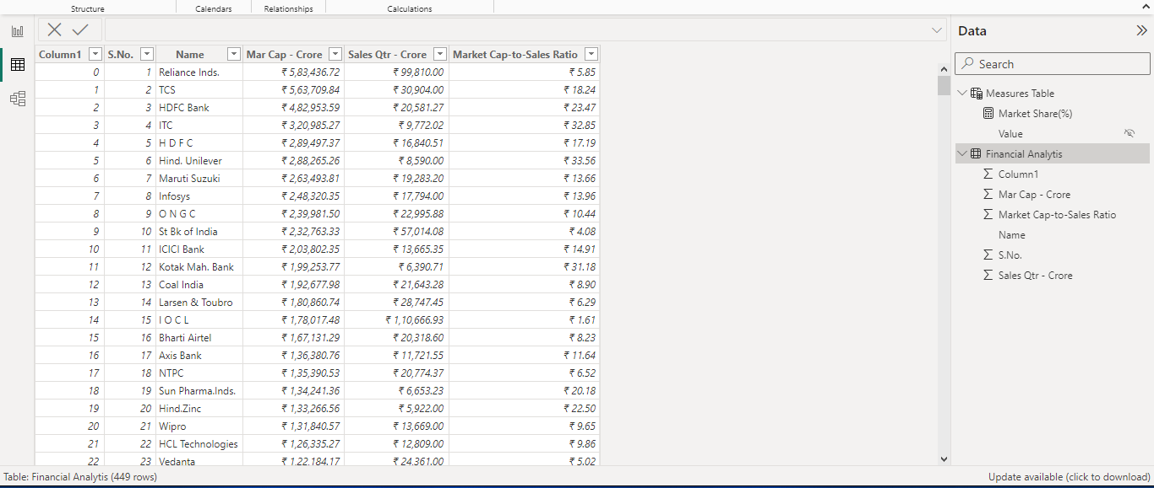
Data Collection: The dataset for this project was obtained from my internship at Unified Monitor. However, it presented some data quality issues, including the presence of NaN values and unnamed columns resulting from data entry errors. Notably, the dataset initially included 489 companies' data instead of the expected 500, and after data cleaning and preprocessing, it was further refined to 449 companies. Importantly, there were no duplicate rows in the dataset.

Slide 4
Key Findings:
The analysis reveals that Reliance Industries remains consistent in its market standing. However, the relatively higher Market Cap-to-Sales ratio suggests the need for efficient sales-to-market value transformation. This recommendation also applies to other companies like Hindustan Unilever and Kotak Mahindra Bank.
In the given quarter, companies with lower Market Cap have captured a higher market share, such as IOCL with a 6.36% market share and Rs 0.18 trillion market cap, compared to TCS with only a 1.76% market share and Rs 0.56 trillion market cap.
Approximately 21 companies show zero market share for the given quarter. I suspect either the data is missing, or the quarter has been challenging for these companies.

Slide 5
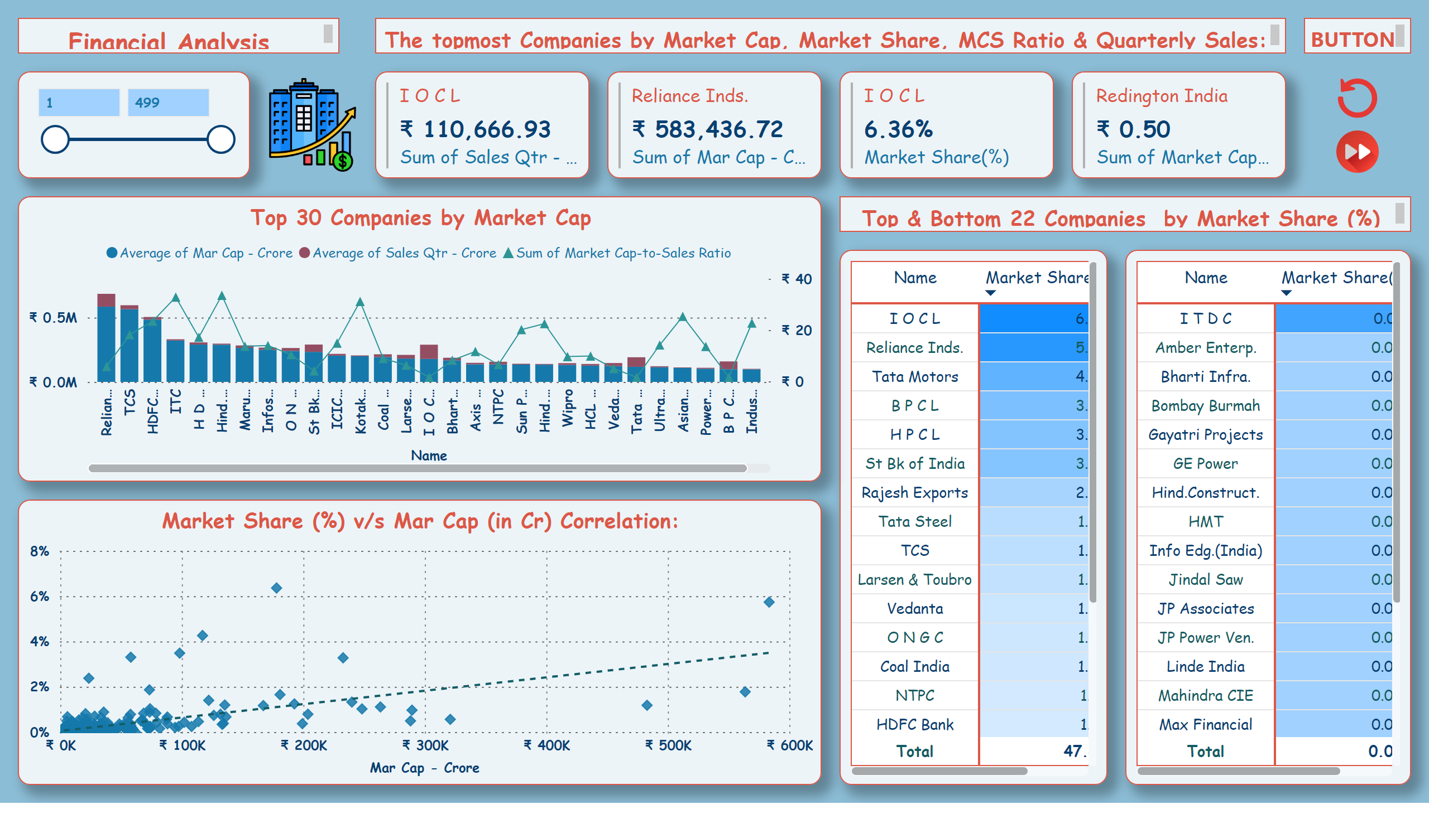
MANAGEMENT DASHBOARD
Notes:
Market Share (%) v/s Mar Cap (in Cr) Correlation:
No alt text provided
slicer
No alt text provided
multiRowCard
No alt text provided
multiRowCard
No alt text provided
multiRowCard
No alt text provided
multiRowCard
No alt text provided
pivotTable
No alt text provided
pivotTable
No alt text provided
Top 30 Companies by Market Cap
No alt text provided
textbox
No alt text provided
textbox
No alt text provided
textbox
No alt text provided
image
No alt text provided
textbox
No alt text provided
image
No alt text provided
image
No alt text provided

Slide 6
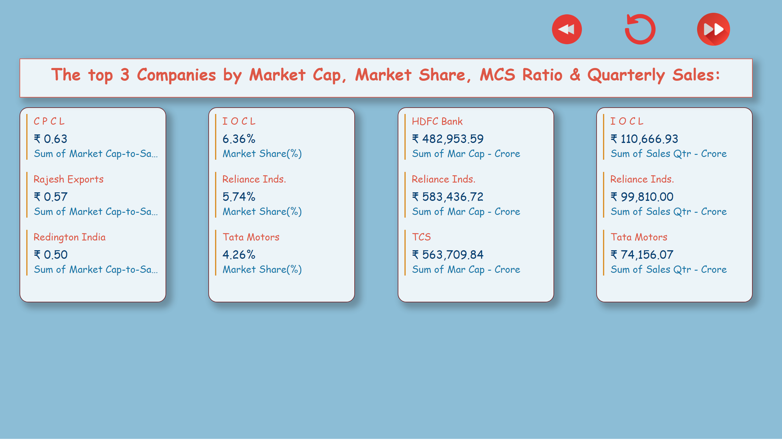
TOP 3 BY
Notes:
image
No alt text provided
image
No alt text provided
image
No alt text provided
textbox
No alt text provided
multiRowCard
No alt text provided
multiRowCard
No alt text provided
multiRowCard
No alt text provided
multiRowCard
No alt text provided

Slide 7
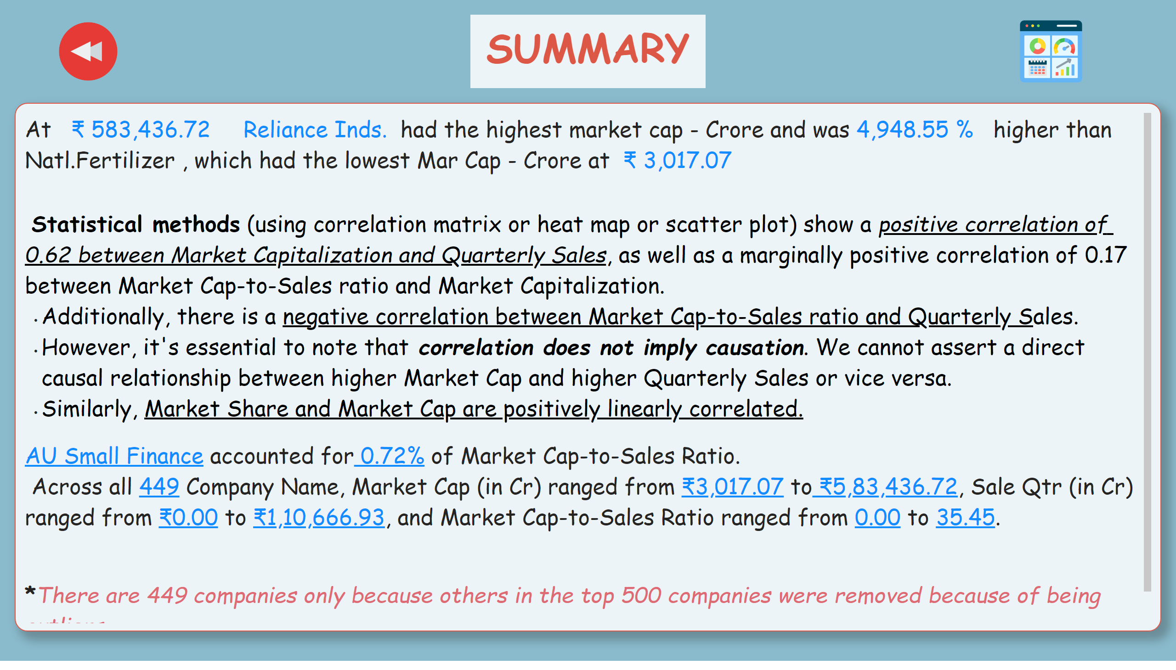
INSIGHT
Notes:
textbox
No alt text provided
textbox
No alt text provided
image
No alt text provided
image
No alt text provided

Slide 8
Limitations and Caveats:
Here, I must confess that the analysis could have revealed more insights if there were additional data variables in the dataset, such as datetime data, sales data for multiple quarters, and the like.
There might be inadvertent biases on my part in selecting metrics and adopting statistical techniques to analyze how the given companies are competing.
Therefore, it is advised not to draw any conclusive inferences from this analysis, especially if the inferences are potentially harmful to any party.
Here, I have simply aimed to enhance my analytical acumen in the financial domain.
Recommendations for Management:
Businesses could benefit from the above analysis if they are dealing with a similar dataset.
By addressing contributing factors hindering their business growth among peer companies, such as a higher Market Cap-to-Sales ratio over time or the menace of overvaluation, organizations can make informed decisions to enhance their strategic positioning.

Slide 9
Conclusion:
This project aimed to leverage the provided dataset and its limited variables to analyze potential patterns in competition among companies. It provided me with an opportunity for learning and enhancing both my Python programming skills and Power BI visualization creativity.

Slide 10
THANK YOU

